Slide 1
Development of a Card Game Management Application within a Real & Virtual Environment
3rd Year Project
Oral Presentation
Realised by:
Boris LENG
Bastien CARRE
Lyvia LOUISIUS
Andrei BROUSSILLON
Supervising professors:
Catherine MARECHAL
Elizabeth COLIN
Lamine BOUGUEROUA

Slide 2
Introduction
Blue Weasel
This is a revolution !!!

Slide 3
Contents
I- Presentation of the project
II- State Of The Art
III- Functional Requirements
IV- Gantt Chart & Work division
V- Conclusion

Slide 4
Presentation of the project
Objectives
Card Game Application
Real/Virtual Environment
Interactions
Technologies
RFID
JavaEE/Android
C++
SQL
Available equipment
4 Pegoda Mifare readers
34 RFID cards
2 Nexus 7 tablets running Android 4.2
2 Lab Computers & personal laptops

Slide 5
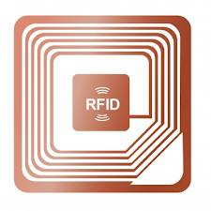
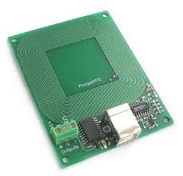
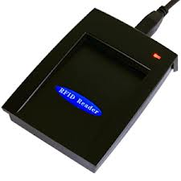
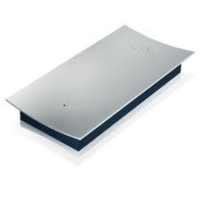
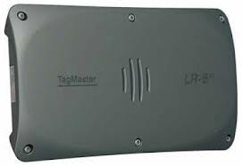
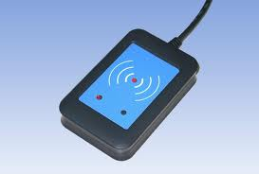
State Of The Art
Antenna
Circuitry

Slide 6
State Of The Art
Various uses of RFID Technology
Credit Card
Pass Navigo
Poker Tournament
Library Cards\Book

Slide 7
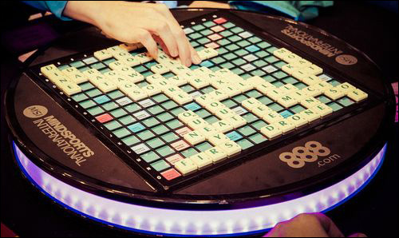
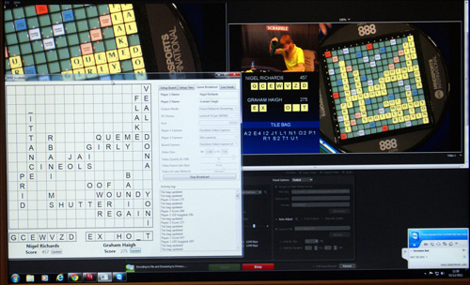
State Of The Art
Every tile has a passive 13.56 MHz RFID tag
225 squares, under each of which there is a single antenna
For antenna holders, each antenna could read the tag of a tile placed within approximately 4 millimeters of that antenna.

Slide 8
State Of The Art
Many Card Game Apps
Belot, Poker, Uno
No interaction with real environment
Tablet is one of the best supports for Card Game
Ergonomy: large multi-touch screen
Easy connection to the Internet

Slide 9
Functional requirements
Description:
Overview
Detailed functionalities:
Signing in
Beginning
Scanning
Playing
Ending
History

Slide 10


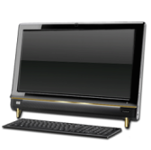

Signing in

Slide 11
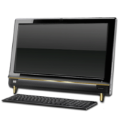
Beginning

Slide 12
Scanning
The Game Application gives instructions to process correctly the dealing
A real player can deal the cards scanning them on the card reader.
He must respect the number of cards and the game order, both indicated by the game Application
Whilst dealing the cards, he must wait for the Application alert and beep before switching from a player to another one.

Slide 13

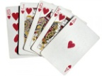

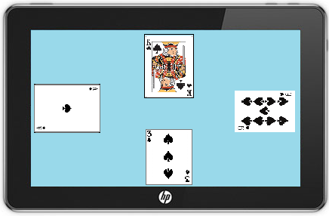
Playing
reader
To play a card, the real player has to scan it whereas the virtual player selects the card from the game application.

Slide 14
Ending
The score is automatically calculated and is displayed at the end of every round, and at the end of the game.
History
Each step of the game is saved and can be viewed later by a signed in user who took part in the game.

Slide 15
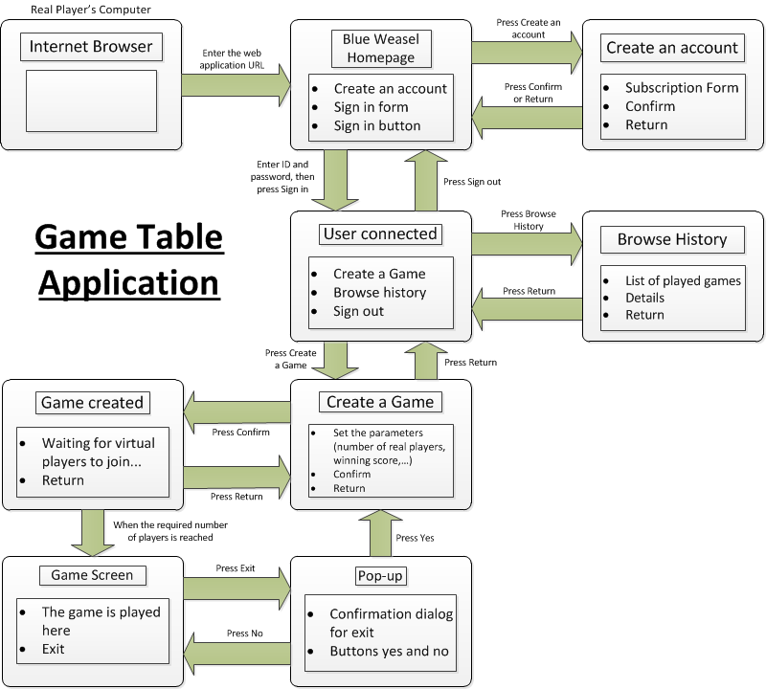
Functional requirements

Slide 16
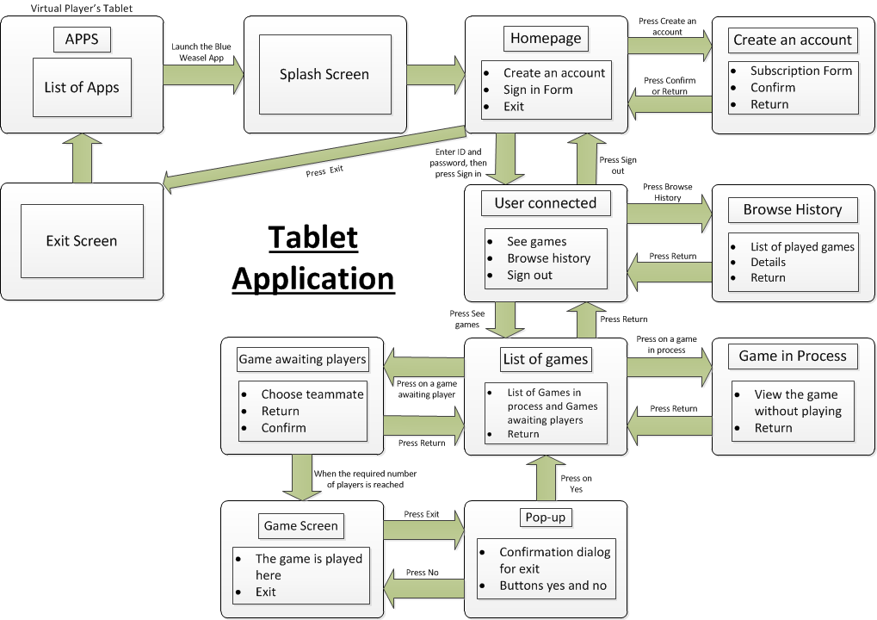

Slide 17
Gantt Chart

Slide 18
Conclusion
Feasibility
Tasks done and remaining tasks
Possible evolution
Notes:
Description:
Possible improvements:
Adaptation of Blue Weasel for other card games with possibly more than four players
Better use of the RFID technology with more recent card readers
Putting Blue Weasel on the cloud

Slide 19

Thank you for your attention!

